Slide 1
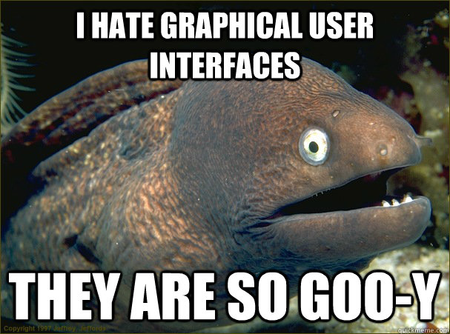
IT 467: Human Factors in Information Systems
Jianwei Lai
jlai12@ilstu.edu

Slide 2
Overview for Today
Interaction Design
User-centered design
Process of Interaction Design
Establishing requirements
Developing alternatives
Prototyping
Evaluating

Slide 3
What is interaction design?
Interaction design, often abbreviated as IxD, is "the practice of designing interactive digital products, environments, systems, and services“.
It is the design of the interaction between users and products.
The Interaction Design Association (IxDA)
http://ixda.org/
https://books.google.com/books?id=0gdRAAAAMAAJ

Slide 4
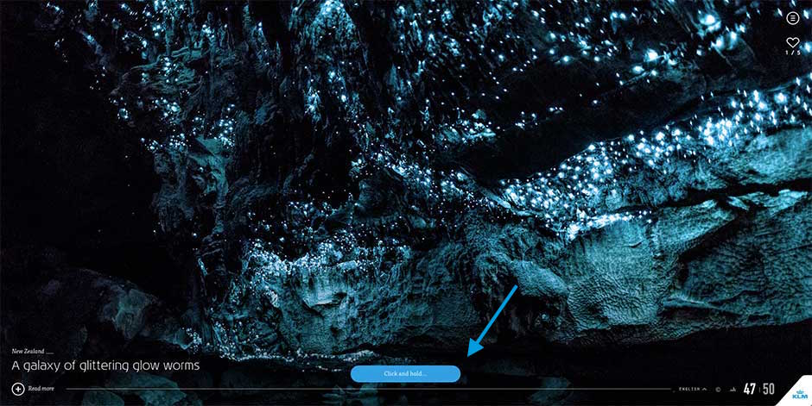
iFly 50 expect its users to click and hold for a few seconds every time they want to see more photos
https://www.interaction-design.org/literature/article/bad-design-vs-good-design-5-examples-we-can-learn-frombad-design-vs-good-design-5-examples-we-can-learn-from-130706
Notes:
Adding Friction to User Actions

Slide 5
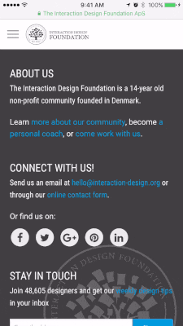
Elastic Scrolling on iOS
Friction can be good

Slide 6
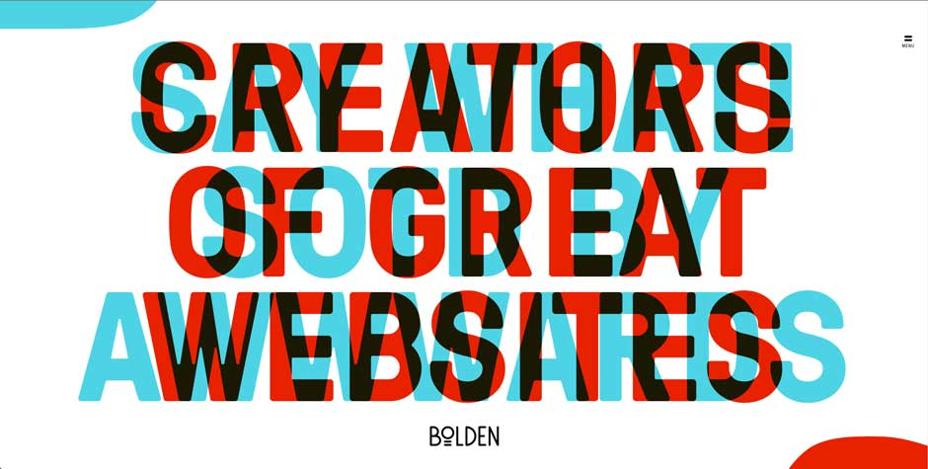

Slide 7
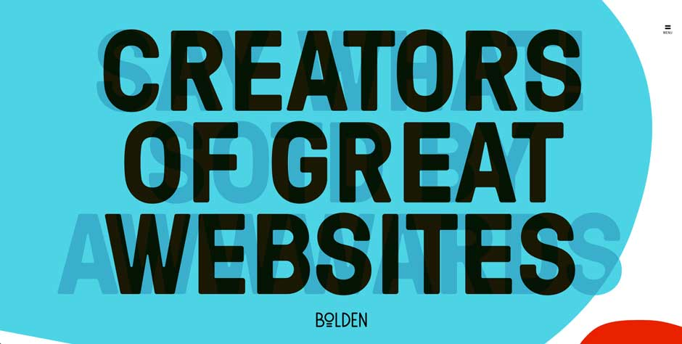
Move your mouse to the corner of the page so as to see the messages properly.
Notes:
It is clever but not a good design

Slide 8
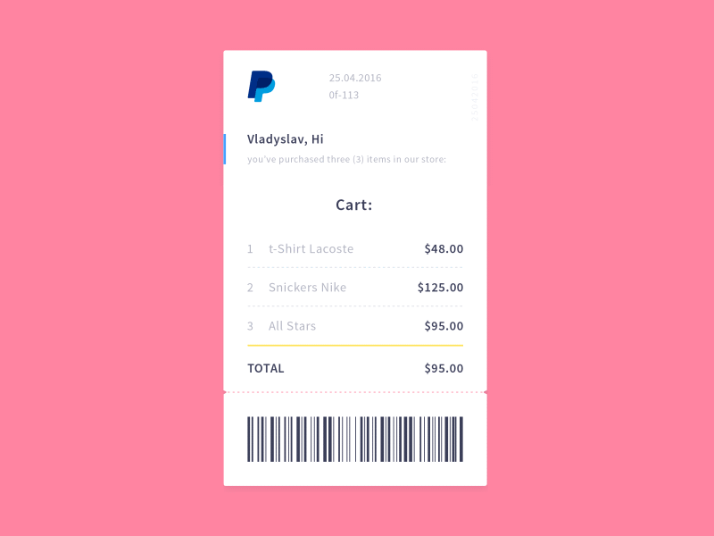
Vladyslav Tyzun’s animation concept for a PayPal email receipt, posted on Dribbble
Notes:
The animation is pretty, but superfluous. In total, it takes a whopping 3.5 seconds to see the transaction details. A simple fade-in of the receipt would be more elegant, and because it takes up less time, better for the user as well.

Slide 9
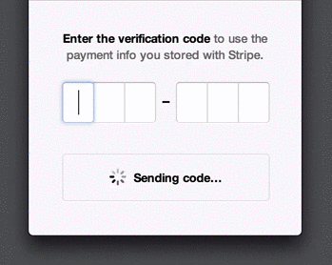
Stripe Checkout’s animation when the user receives a verification code
Notes:
Stripe uses animations to make things seem faster than they are: it provides users with updates (like “Sent”) even though they might not have received the SMS yet. This prevents users from feeling frustrated at having to wait and provides assurance that an SMS is on its way right now.

Slide 10
Four basic activities of Interaction Design
Essentially, the process of interaction design involves four basic activities:
1. Identifying needs and establishing requirements.
2. Developing alternative designs that meet those requirements.
3. Building interactive versions of the designs so that they can be communicated and assessed.
4. Evaluating what is being built throughout the process.

Slide 11
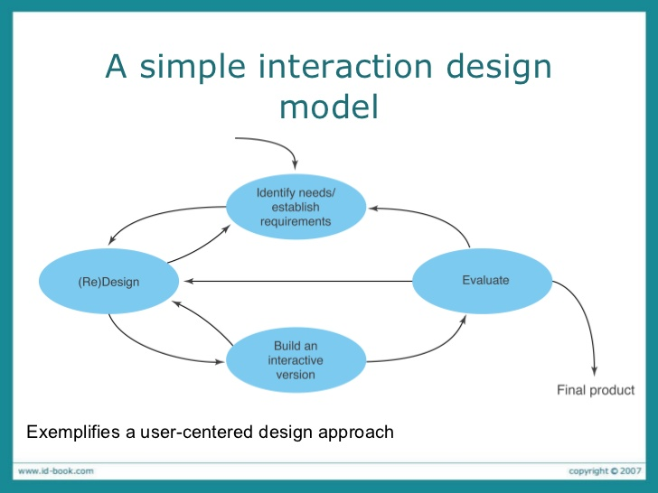

Slide 12
Four Approaches to Interaction Design
User-centered design, activity-centered design, systems design, and genius design
Interaction Design Approaches
User Centered
Activity Centered
Systems Design
Genius Design

Slide 13
User-centered design

Slide 14
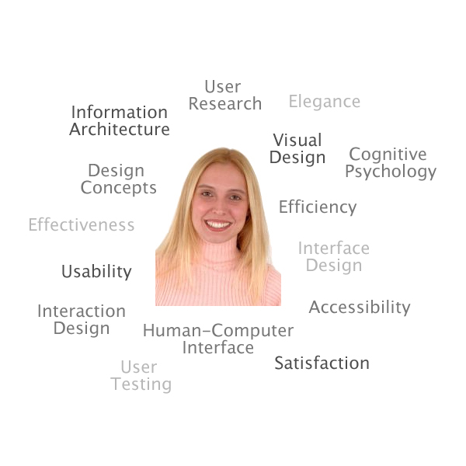

What is User-Centered Design (UCD)?
The user is put in the center of the design
https://wiki.jasig.org/download/attachments/8096535/JASIG+UCamp+UCD+Introduction+-+Fall+07.ppt
Notes:
Gary
User-Centered Design (UCD) - a design philosophy and a process in which the needs, wants, and limitations of the end user of an interface or document are given extensive attention at each stage of the design process. Adapted from Wikipedia, http://en.wikipedia.org/wiki/User_centered_design, 11-7-07.
The goal of user-centered design is to make the user's interaction experience as simple and intuitive as possible.

Slide 15
What is a user-centered approach?
User-centered approach is based on:
Early focus on users and tasks: directly studying cognitive, behavioural, anthropomorphic & attitudinal characteristics
Empirical measurement: users’ reactions and performance to scenarios, manuals, simulations & prototypes are observed, recorded and analysed
Iterative design: when problems are found in user testing, fix them and carry out more tests.
Notes:
Setting a quiz on reggienet?
Who are the users?
How to test the system?
If I designed a version to improve it? How to test a new version?
This means first understanding who the users will be by directly studying their cognitive, behavioral, anthropomorphic, and attitudinal characteristics. This required observing users doing their normal tasks, studying the nature of those tasks, and then involving users in the design process.
Early in development, the reactions and performance of intended users to printed scenarios, manuals, etc. is observed and measured. Later on, users interact with simulations and prototypes and their performance and reactions are observed, recorded, and analyzed.
Iterative design. When problems are found in user testing, they are fixed and then more tests and observations are carried out to see the effects of the fixes. This means that design and development is iterative, with cycles of "design, test, measure, and redesign" being repeated as often as necessary.

Slide 16
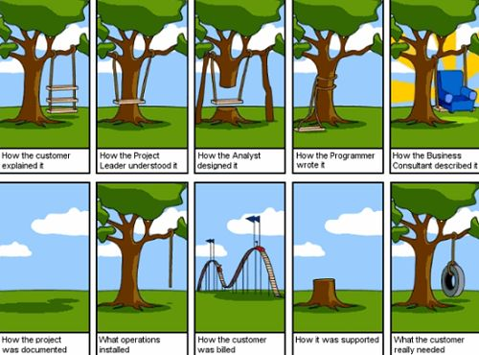
User-Centered design
Focus is on user needs and goals
User is the measurement guide to the designer
Designer’s role is to translate the users’ needs and goals into a design solution
User Centered
Interaction Design Approaches
Genius Design
Activity Centered
Systems Design

Slide 17
User Needs

Slide 18
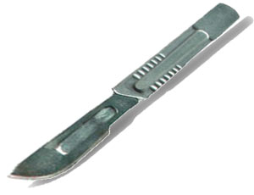
Knife 1

Slide 19
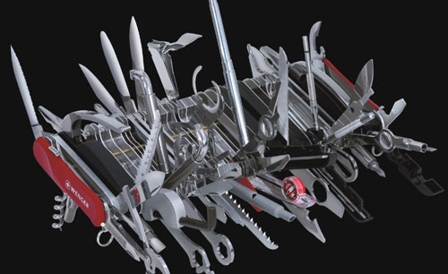
“Knife” 2

Slide 20
Write Answer: which knife is better?
Scalpel
Swiss army
It depends on the needs

Slide 21
Focus on Users’ Needs
Need to take into account:
Who the users are, kids vs. adults
What activities are being carried out, reading news vs. purchasing
Where the interaction is taking place, mobile vs. desktop
Need to optimize the interactions users have with a product, so that they match the users’ activities and needs

Slide 22
Who are the users/stakeholders?
Not as obvious as you think:
those who interact directly with the product
those who manage direct users
those who receive output from the product
those who make the purchasing decision
those who use competitor’s products
Three categories of user (Eason, 1987):
primary: frequent hands-on
secondary: occasional or via someone else
tertiary: affected by its introduction, or will influence its purchase

Slide 23

Why the mailman sits on the right side?

Slide 24
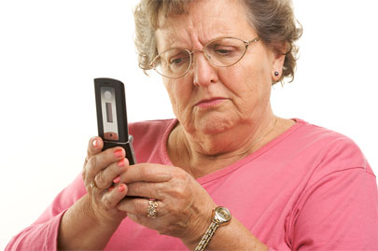
Understanding users’ needs
Need to take into account what people are good and bad at
Consider what might help people in the way they currently do things
Think through what might provide good user experiences
Listen to what people want and get them involved
Use tried and tested user-centered methods
Notes:
24

Slide 25
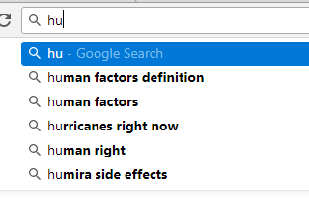
Why the recommendations are useful?
We are good at recognizing things but not good at remembering things
Can help the user find the right key words

Slide 26
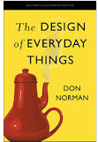
Conceptual Model
How do you use a teapot to make some hot tea and drink it with a cup?

Slide 27
Conceptual Model
https://www.youtube.com/watch?v=pAOyWFOFhsg
https://www.youtube.com/watch?v=OZHrCEDl1-g&t=19s
More interesting videos
https://www.youtube.com/watch?v=fy-J_E55rw0&list=PLAwxTw4SYaPlr4Uq3RoYuwlDADp0WQdGl

Slide 28
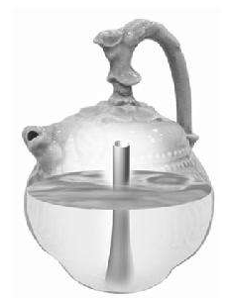
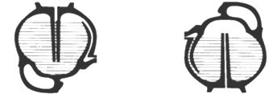
Conceptual model vs mental model
https://uxmag.com/articles/the-secret-to-designing-an-intuitive-user-experience
Notes:
If I tell them that I recently ordered a steak at a restaurant, they might assume that I was met at the door by a host or hostess, seated, and presented with a menu. They assume these details, and others, that I never actually mentioned because they have a mental model of how restaurants operate. To illustrate the consequences of having a mismatched mental model, I describe a person who goes into a buffet restaurant and waits for someone to take their order. The person’s mental model of how that restaurant operates doesn’t match the actual situation, and he would experience confusion and frustration until he modified his original model to include buffets.

Slide 29
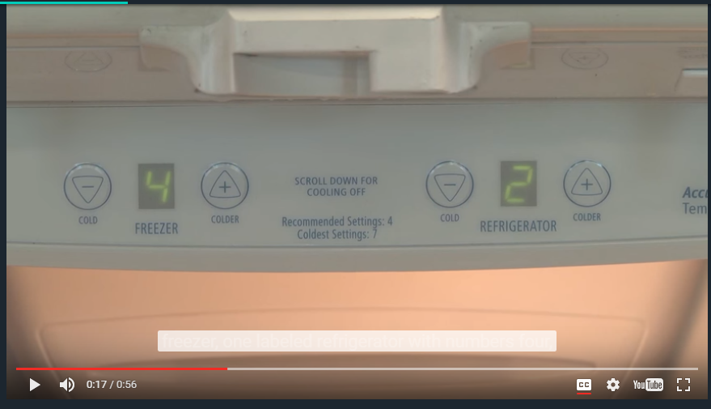
Bad conceptual model
Notes:
Bad conceptual model
What does 4 and 2 mean?

Slide 30
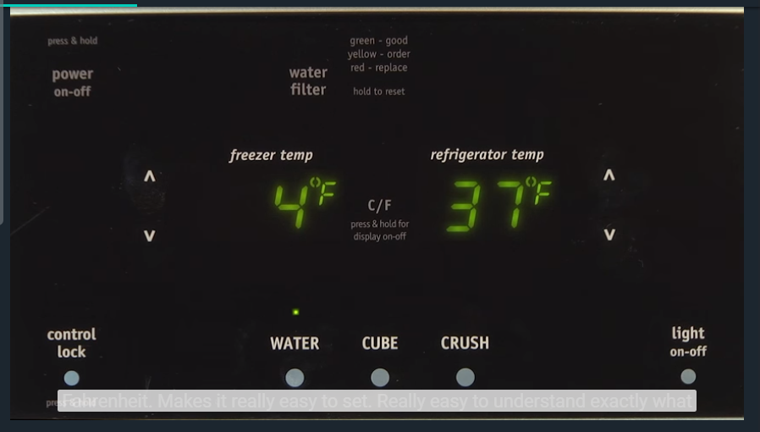
Good conceptual model
Notes:
Good conceptual model

Slide 31


User Needs Assessment
Surveys
Interviews
Focus groups
Advanced observation techniques
Field studies
Ethnography
Contextual inquiries
https://www.surveymonkey.com/
https://illinoisstate.az1.qualtrics.com/ControlPanel/
https://www.youtube.com/watch?v=nV0jY5VgymI
Read: http://usabilitypost.com/2009/09/09/contextual-interviews-and-ethnography/
Notes:
Allison
* Talk to and observe users
Survey – Good technique for gathering less specific more quantitative data from large number of users.
Interview - Structured and/or open-ended, Talk to actual end users-they are usually not the project sponsors. Encourage interviewee to speak freely and give you honest answers and feedback to determine their needs, goals & tasks.
Focus group – a group of potential users or stakeholders in a product who are brought together to gather information as input to the design process.
Advanced observation - techniques allow you to observe users to determine that what they say they do is really what they do (not today, future learning opportunity):
Field Study- a researcher goes on site and observes and asks questions
Contextual Inquiry – a structured field interviewing method, based on a few core principles that differentiate this method from plain, journalistic interviewing – context in which product used, user is a partner, there is a definite goal:
understanding the context in which a product is used (the work being performed) is essential for elegant design
the user is a partner in the design process
the usability design process, including assessment methods like contextual inquiry and usability testing, must have a focus (goal). (e.g. "We need to know how they store their wrenches“)
Ethnography - an approach to research which involves in-depth study through observation, interviews, and artifact analysis in an attempt to gain a thorough understanding from many perspectives.

Slide 32
Contextual inquiries
Contextual inquiry is a semi-structured interview method to obtain information about the context of use, where users are first asked a set of standard questions and then observed and questioned while they work in their own environments.
It’s not simply an interview, and it’s not simply an observation.
It involves observing people performing their tasks and having them talk about what they are doing while they are doing it.
http://www.usabilitybok.org/contextual-inquiry
Read: http://www.uxmatters.com/mt/archives/2012/06/why-are-contextual-inquiries-so-difficult.php

Slide 34
How to generate alternatives？
Humans stick to what they know works
But considering alternatives is important to ‘break out of the box’
How do you generate alternatives?
‘Flair and creativity’: research and synthesis
Seek inspiration: look at similar products or look at very different products
Notes:
A common human tendency is to stick with something that we know works. We probably recognize that a better solution may exist out there somewhere, but it's very easy to accept this one because we know it works-it's "good enough.“
Settling for a solution that is good enough is not, in itself, necessarily "bad," but it may be undesirable because good alternatives may never be considered, and considering alternative solutions is a crucial step in the process of design.
We choose between alternative designs by letting users and stakeholders interact with them and by discussing their experiences, preferences and suggestions for improvement. This is fundamental to a user-centered approach to development. This in turn means that the designs must be available in a form that can be reasonably evaluated with users, not in technical jargon or notation that seems impenetrable to them.

Slide 36
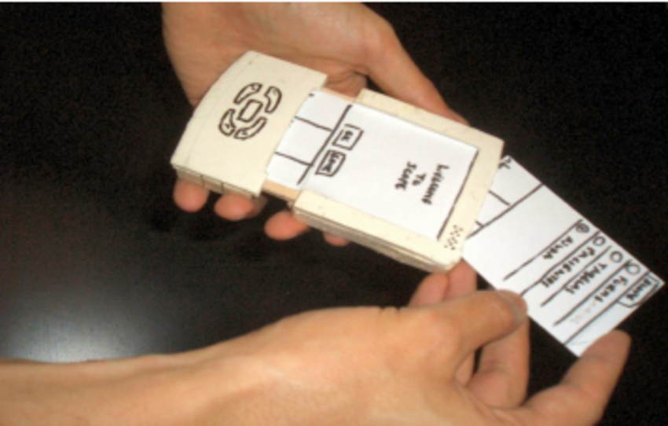
What is a prototype?
In interaction design it can be (among other things):
a series of screen sketches
a storyboard, i.e. a cartoon-like series of scenes
a Powerpoint slide show
a video simulating the use of a system
a lump of wood (e.g. PalmPilot)
a cardboard mock-up
a piece of software with limited functionality written in the target language or in another language

Slide 37
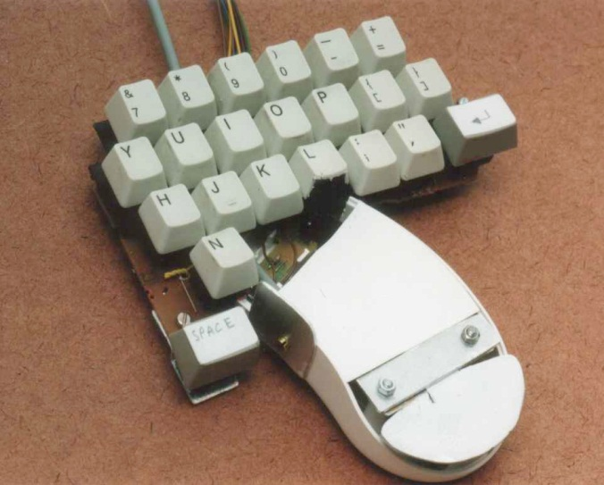
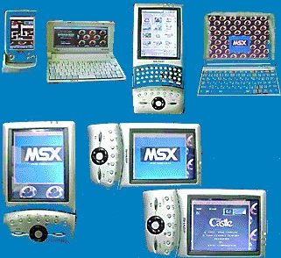
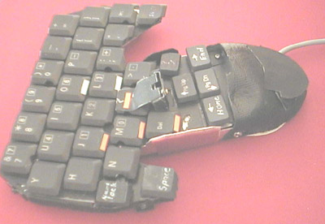
Testing prototypes to choose among alternatives

Slide 38
Why prototype?
Feedback early, cheap
Stakeholders can see, hold, interact with a prototype more easily than a document.
Team members can communicate effectively
You can test out ideas for yourself
It encourages reflection: very important aspect of design
Experiment with alternatives

Slide 39
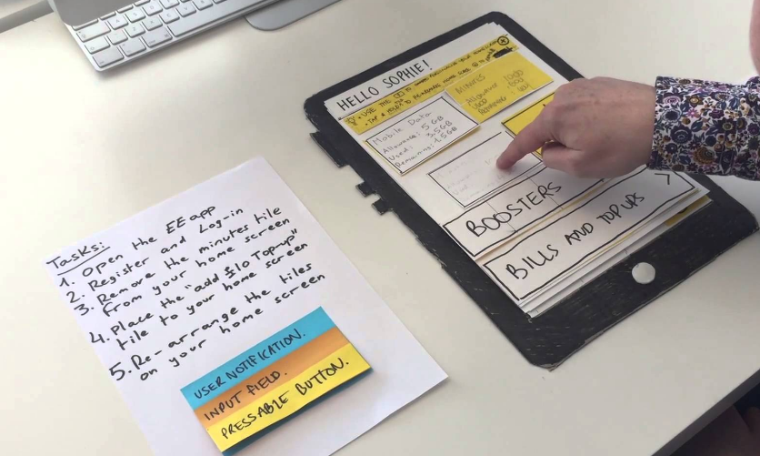
Low-fidelity Prototyping
Fidelity – how similar it is to the finished interface
Uses a medium which is unlike the final medium, e.g. paper, cardboard
Omits details
Is quick, cheap and easily changed
Examples: - sketches of screens, task sequences, - ‘Post-it’ notes - storyboards - ‘Wizard-of-Oz’

Slide 40
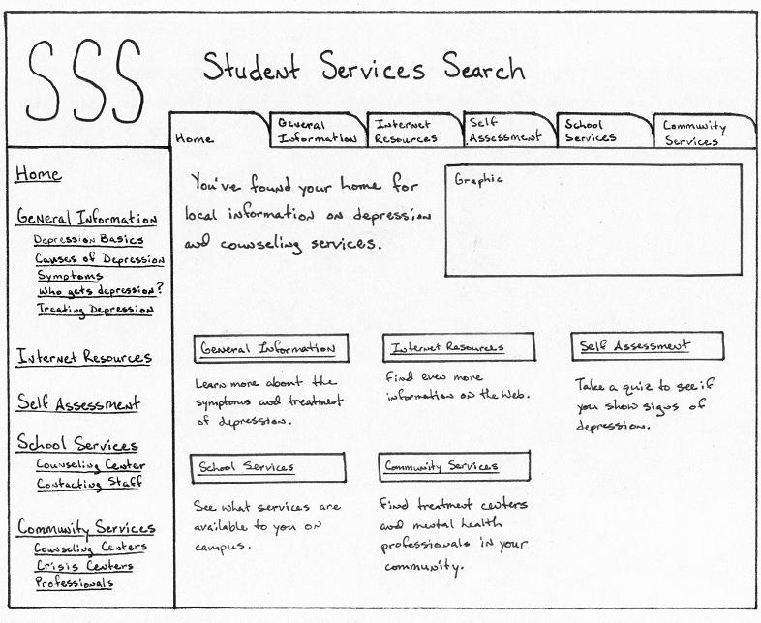
Low-Fidelity Prototype example

Slide 41
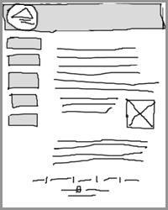
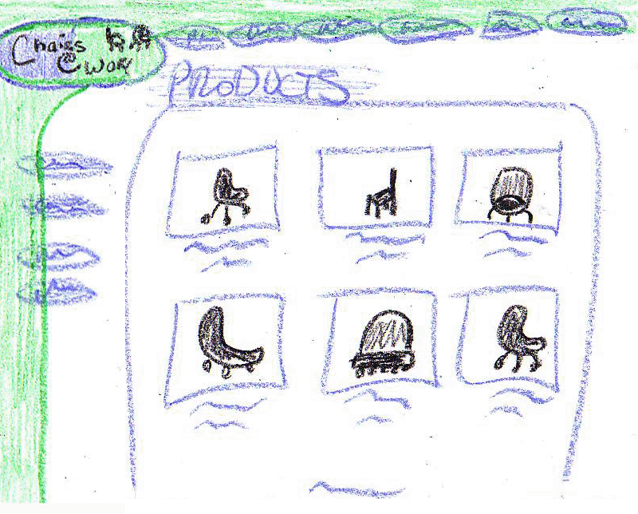
Sketching
Sketching is important to low-fidelity prototyping
Don’t be inhibited about drawing ability.

Slide 42
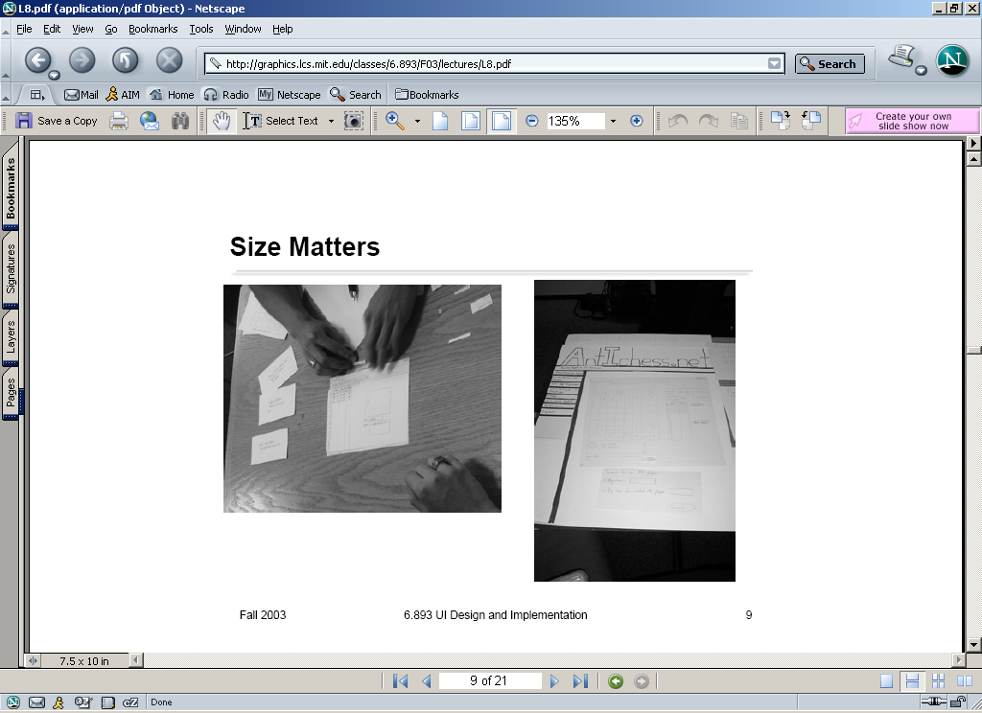
Paper Prototypes

Slide 43
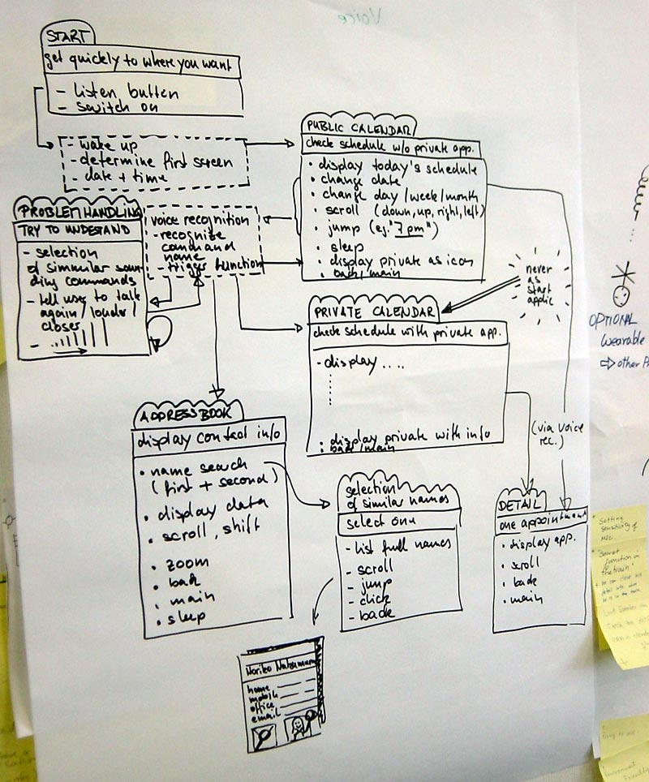
Storyboards
Often used with scenarios, bringing more detail, and a chance to role play
Series of sketches showing how a user might progress through a task using the device
Used early in design

Slide 44
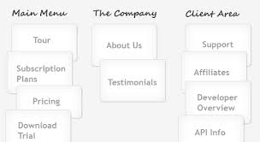
Index cards and Post-its
Index cards (3 X 5 inches)
Each card represents one screen
Often used in website development
Notes:
Check isu website

Slide 45
‘Wizard-of-Oz’ prototyping
The user thinks they are interacting with a computer, but a developer is responding to output rather than the system. Human in the loop to help
Usually done early in design to understand users’ expectations
“Wizard of Oz” = “man behind the curtain”
https://www.youtube.com/watch?v=d8SEFSpBYzY

Slide 46
High-fidelity prototyping
Uses materials that you would expect to be in the final product
Similar to finished product
Prototype looks more like the final system than a low-fidelity version.

Slide 47
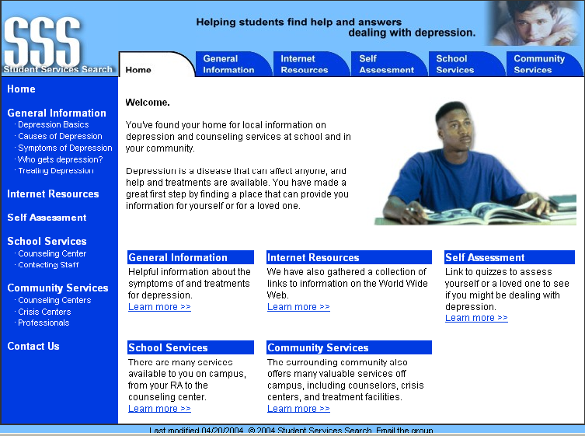
High-Fidelity Prototype example

Slide 48
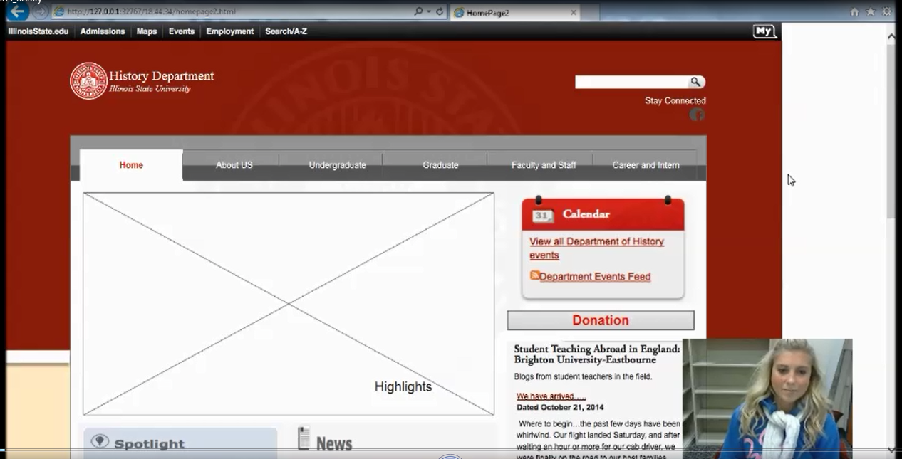
Example of Prototype test

Slide 50
Summary
Four basic activities in the design process:
Establishing requirements
Designing alternatives
Prototyping
Evaluating
User-centered design rests on three principles:
Early focus on users and tasks
Empirical measurement using quantifiable & measurable usability criteria
Iterative design

Slide 51
Article to read
Don't Listen to the Customers
Summary: The first rule of user experience design is: don't base the product on what customers *say* they want. You must watch what people actually *do* when using your design.
https://www.nngroup.com/videos/dont-listen-to-customers/

Slide 52
Article to read
Why Are Contextual Inquiries So Difficult?
https://www.uxmatters.com/mt/archives/2012/06/why-are-contextual-inquiries-so-difficult.php

